Slide 1

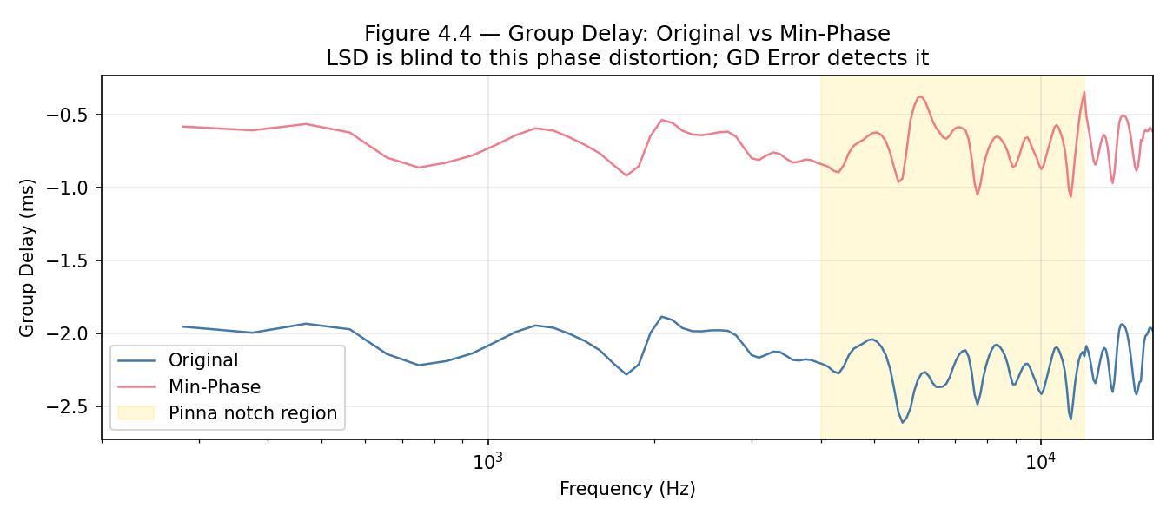
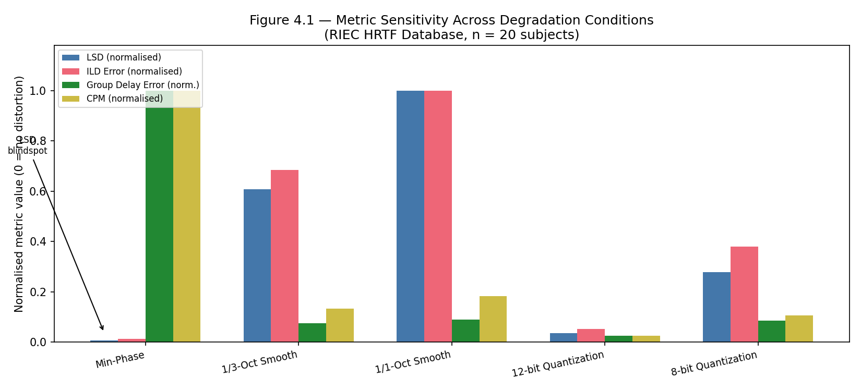
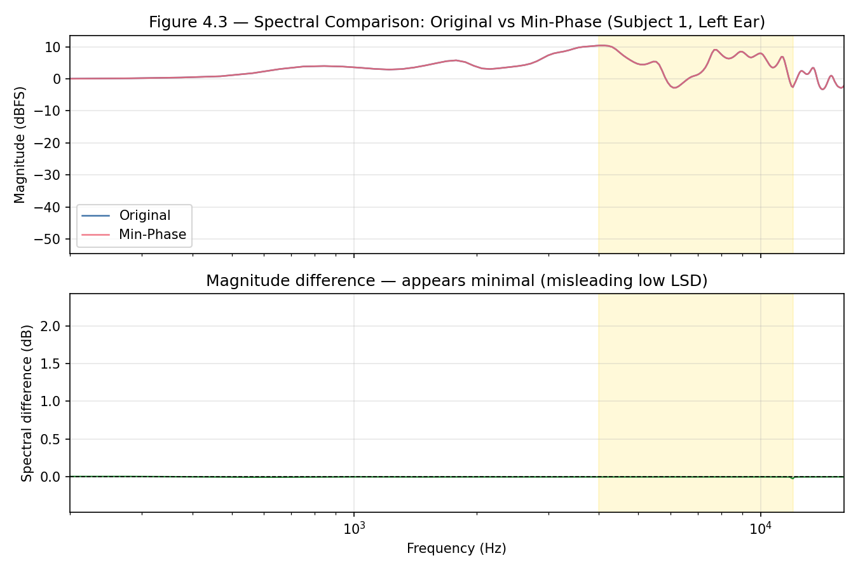
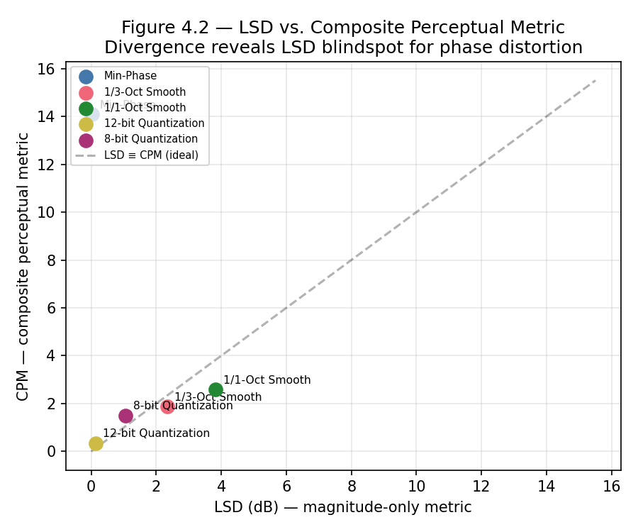
Objective Head-Related Transfer Function Evaluation Metrics for More Consistent Perceptual Assessment
Shanghao Zou, Dr. Baha Ihnaini
Department of Computer Science and Technology, Wenzhou-Kean University, Wenzhou, China
Introduction
Results
HRTFs are acoustic filters encoding how anatomy (head, pinnae, torso) transforms sound — the cornerstone of spatial audio rendering over headphones.
The industry-standard metric, Log-Spectral Distortion (LSD), operates only in the magnitude domain and poorly predicts perceptual quality.
The "LSD Blindspot": Andreopoulou & Katz (2022) demonstrated that minimum-phase reconstruction achieves LSD < 1 dB ("perfect" by industry standards) yet caused massive subjective decorrelation (r ≈ 0.5), inverting quality rankings for ~18% of HRTFs.
LSD fails because: (1) it is blind to phase information; (2) it is monaural, missing binaural cues; (3) it weights all frequencies equally, ignoring perceptually critical pinna notch regions (4-12 kHz).
This thesis proposes a Composite Perceptual Metric (CPM) combining LSD, ILD error, Group Delay error, and ITD error into a single weighted score that captures both magnitude and phase degradations.
Central Finding: Minimum-phase reconstruction achieves the LOWEST LSD (0.030 dB) of all conditions yet produces the HIGHEST CPM (14.094) — over 5× higher than the next worst condition.
Metric Results Table (mean ± std, n=20 subjects):
Condition | LSD (dB) | ILD Err (dB) | GD Err (ms) | CPM
Min-Phase | 0.030 ± 0.007 | 0.058 ± 0.014 | 2.335 ± 0.178 | 14.094 ± 1.29
1/3-Oct Smooth | 2.332 ± 0.204 | 3.122 ± 0.241 | 0.176 ± 0.018 | 1.880 ± 0.15
1/1-Oct Smooth | 3.829 ± 0.265 | 4.562 ± 0.284 | 0.209 ± 0.017 | 2.592 ± 0.12
12-bit Quant. | 0.140 ± 0.032 | 0.238 ± 0.054 | 0.060 ± 0.012 | 0.352 ± 0.07
8-bit Quant. | 1.065 ± 0.213 | 1.730 ± 0.332 | 0.202 ± 0.029 | 1.503 ± 0.24
Group Delay Error: at 2.335 ms, min-phase GD error is 11–39× larger than any other condition, driving the extreme CPM score.
For the four non-minimum-phase conditions, CPM increases monotonically with degradation severity (12-bit < 8-bit < 1/3-oct < 1/1-oct), confirming CPM retains sensitivity to magnitude-domain distortions.
The LSD vs. CPM scatter plot (Figure 2) reveals the fundamental divergence: min-phase sits at LSD ≈ 0 but CPM ≈ 14, far from the diagonal — empirical proof of the LSD blindspot.
Conclusions
1. LSD Blindspot Confirmed: Minimum-phase reconstruction achieves LSD = 0.030 dB (best of all conditions) yet CPM = 14.094 (worst). This provides empirical support for Andreopoulou & Katz (2022) on an independent database.
2. Group Delay Error is the Key Discriminator: At 2.335 ms — over 10× larger than any other condition — it is the component that catches what LSD misses.
3. CPM Captures Both Domains: For non-phase-altering conditions, CPM monotonically tracks degradation severity, confirming it does not sacrifice magnitude sensitivity.
Limitations
No subjective listening tests conducted
CPM weights are heuristic (JND-based)
only 20 of 51 subjects used.
Future Work
MUSHRA subjective validation
SADIE II cross-validation
Empirical CPM weight optimization
CPM as ML training loss function
Frequency-dependent weighting for pinna notch region (4-12 kHz).
Methods and Materials
Dataset: RIEC HRTF Database (Tohoku University) — 20 subjects (10M/10F), 865 spatial positions each, 512-sample HRIRs at 48 kHz (SOFA format).
Five Degradation Conditions applied as targeted metric stress-tests:
A. Minimum-Phase Reconstruction — real-cepstrum method; preserves magnitude, destroys phase. ITD re-inserted via onset detection.
B. 1/3-Octave Magnitude Smoothing — mild spectral detail loss, phase preserved.
C. 1/1-Octave Magnitude Smoothing — aggressive smoothing, obliterates pinna notches.
D. 12-bit Quantization — broadband noise floor ~-72 dB; minimal distortion.
E. 8-bit Quantization — severe noise floor ~-48 dB; clearly audible.
Four Metrics computed per subject-condition pair (200–16,000 Hz):
LSD (dB) | ILD Error (dB) | Group Delay Error (ms) | ITD Error (ms)
CPM = 0.20·LSD/2.0 + 0.25·ILDerr/1.0 + 0.35·GDerr/0.08 + 0.20·ITDerr/0.03
Weights reflect psychoacoustic JND thresholds;
GD receives highest weight (0.35) as phase-sensitive key discriminator.
References
[1] Andreopoulou & Katz. JAES 70(5):340-354, 2022.
[2] Gebru et al. arXiv:2508.10924, 2025.
[3] Armstrong et al. JASA 156(6):4133-4152, 2024.
[4] Panah et al. arXiv:2505.11915, 2025.
[5] Ananthabhotla et al. JASA Express Letters, 1(4), 2021.
[6] Watanabe et al. RIEC HRTF Database, Tohoku Univ., 2014.
[7] Kistler & Wightman. JASA 91(3):1637-1647, 1992.
[8] Zhang et al. arXiv:2507.02815, 2025.

